Slide 1
Web Scraping of Online Drug Markets
January 2020
Jacob Miller (jacob.miller@canada.ca)
Office of Drug Research and Surveillance
Controlled Substances and Cannabis Branch
Health Canada

Slide 2
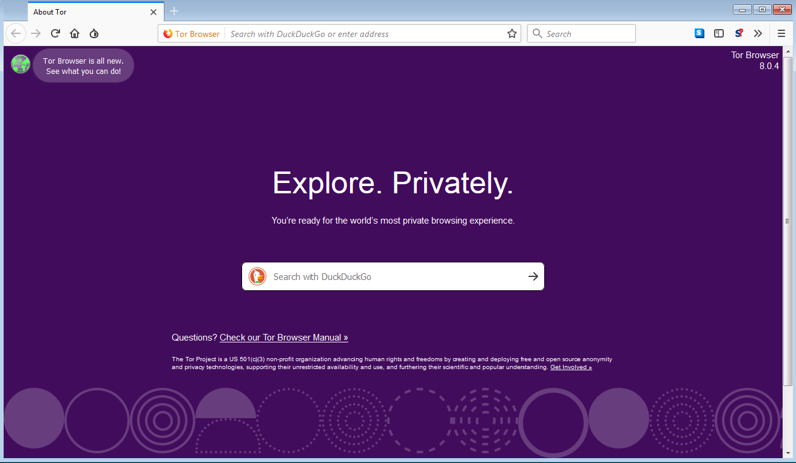
The dark web - Tor
The dark web is a portion of the internet that requires specific software (i.e. Tor) to access.
Tor routes the data coming to and from the user through several relays, which are run by the community.
Otherwise, it functions as a normal browser.

Slide 3
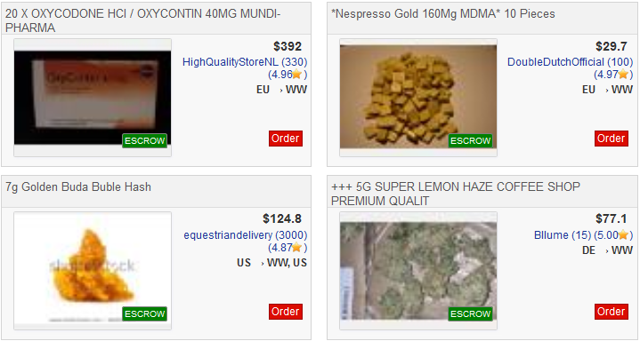
Creating a database from a dark web market pages
Any dark web market will have a database of their listings. There is no way to access the source database, but it can be reverse-engineered.
Listing title | Price | Seller | Ships from | Ships to
20 X OXYCODONE HCI / OXYCONTIN 40MG MUNDI-PHARMA | $392 | A | EU | WW
*Nespresso Gold 160Mg MDMA* 10 Pieces | $29.70 | B | EU | WW
7g Golden Buda Buble Hash | $124.80 | C | US | WW, US
+++ 5G SUPER LEMON HAZE COFFEE SHOP PREMIUM QUALIT | $77.1 | D | DE | WW
Notes:
Basically, the people running Dream Market create the website by saying “for each row in our database of listings, create a little box. The listing title variable goes here at the top, the price goes here, etc”. They just need to ‘design’ one box, and then they can loop through their database with the same logic for all 80,000 listings.
To re-create the database from the web page, I just create a process that loops through each box in the page, and creates a new row in my database where the title field gets its data from the appropriate HTML field, same for the price and so on. Just like them, I just need to write out the logic for one box, and then loop through the rest of them.

Slide 4
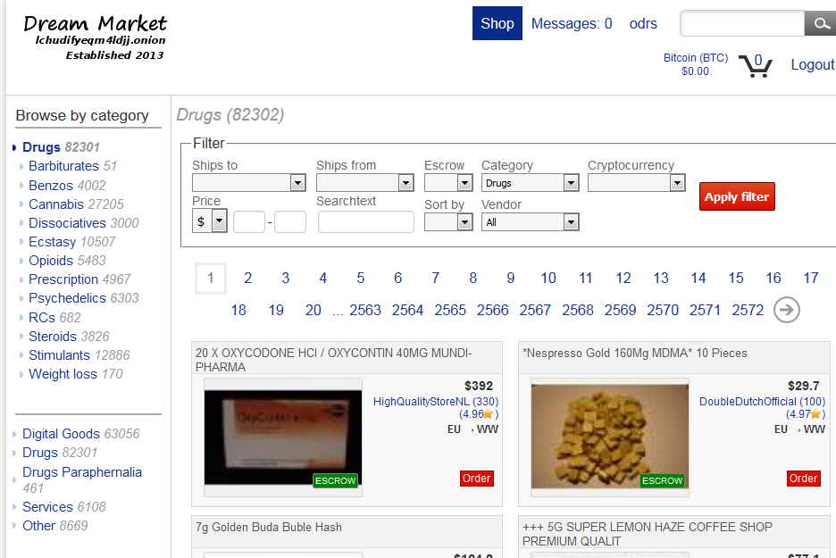
Drugs on the dark web
Notes:
As the previous slide showed, drugs are the largest category on the dark web. This is the Dream Market, the largest operating market on the dark web. The website operates as a host for users to sell drugs from consumer to consumer. Anyone can make a listing or purchase. Although they sell other things, drugs are their largest category with over 80,000 listings. For our purposes, they are essentially the ebay of drugs.

Slide 5
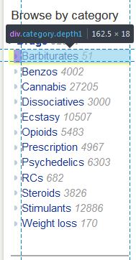
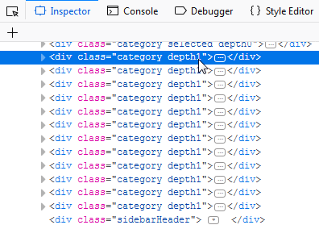
Scraping
The general concept of scraping is to look at the HTML code of the web page and look for patterns in the way the data is stored.
In the example below, you can see that each of the category links is held in a div class named “category depth1”. This can be used to loop through each of these specific sections.

Slide 6


Slide 7


Slide 8
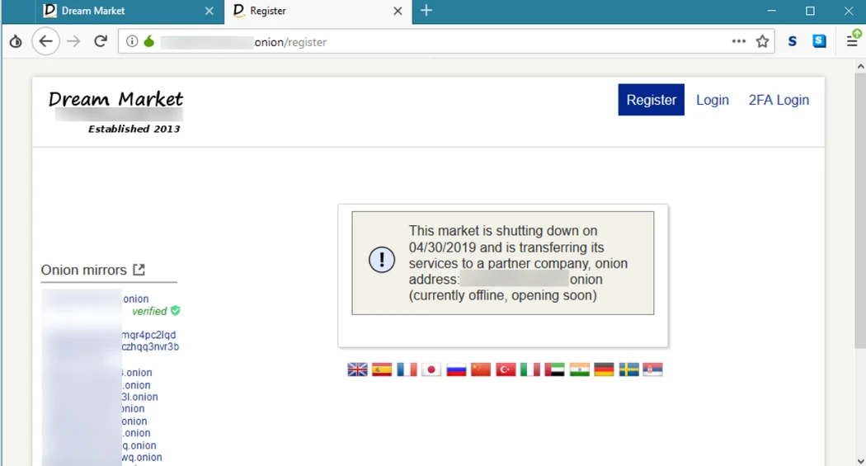

Slide 9
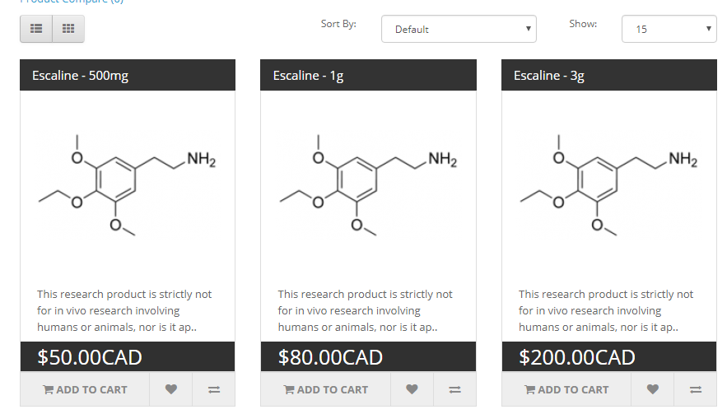
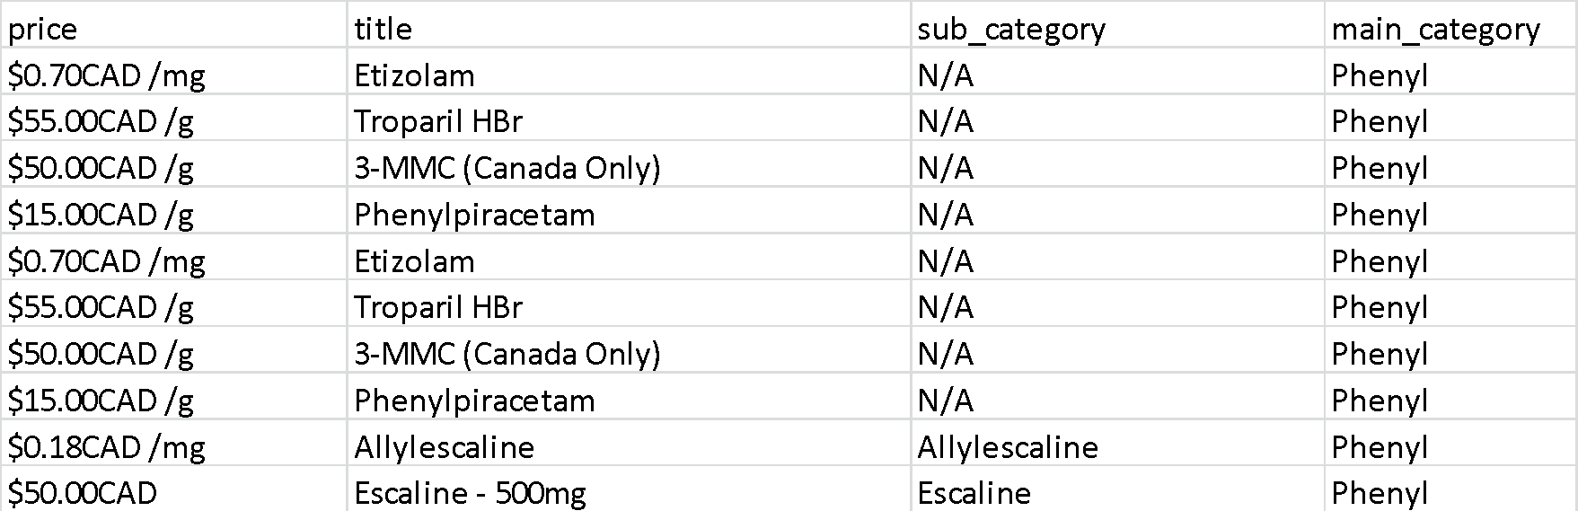
Open web research chemical example
As opposed to ebay-style consumer-to-consumer markets found on the dark web, open web drug sellers sell direct to consumer by selling legal drugs that have a psychoactive effect.
Notes:
As opposed to ebay-style consumer-to-consumer markets that are found on the dark web, what we find on the open web are business-to-consumer models. This makes it much easier to scrape the data, as it means that there will be one listing per drug, as opposed to thousands of listings just for different people selling meth.
Scraping the open web is essentially the same process. So far, ReChem has been scraped, as I’ve seen it as the most commonly mentioned supplier on research chemical discussion forums.

Slide 10
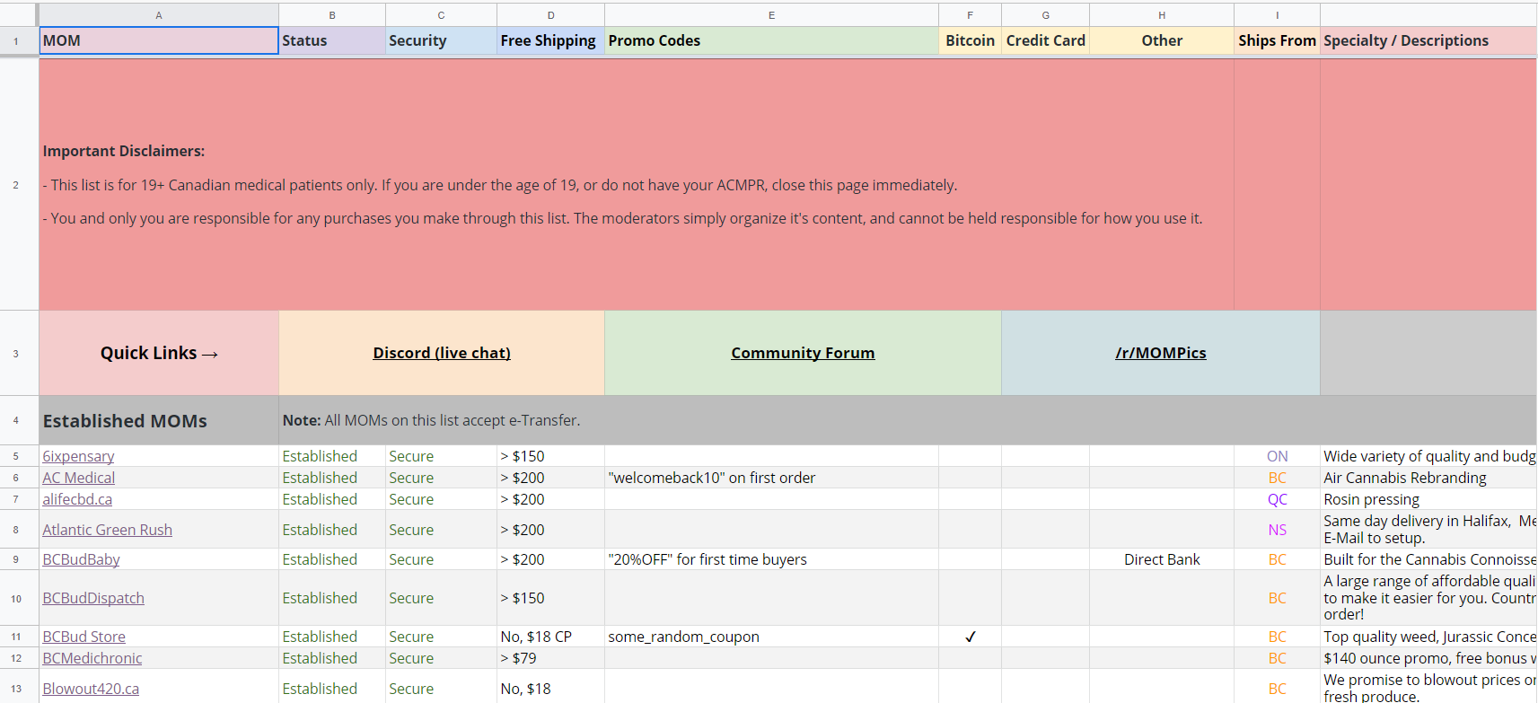
Canadian Mail Order Marijuana websites
300+ Canadian websites selling marijuana online

Slide 11
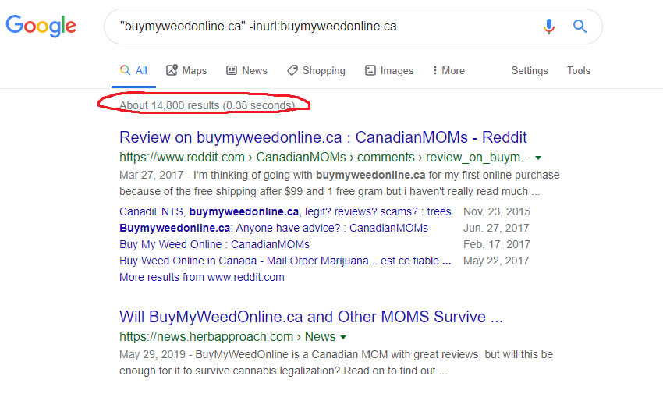
Finding the most popular sites

Slide 12
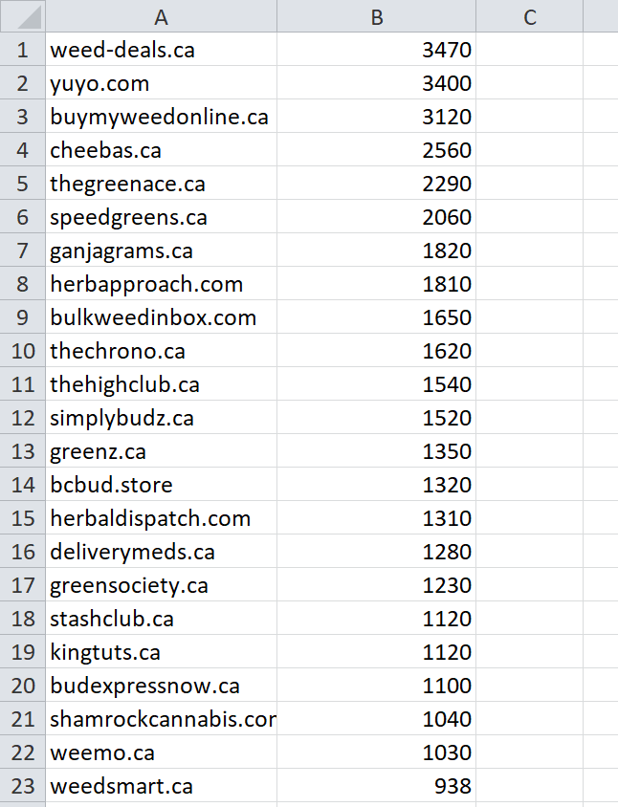
Finding the most popular sites

Slide 13
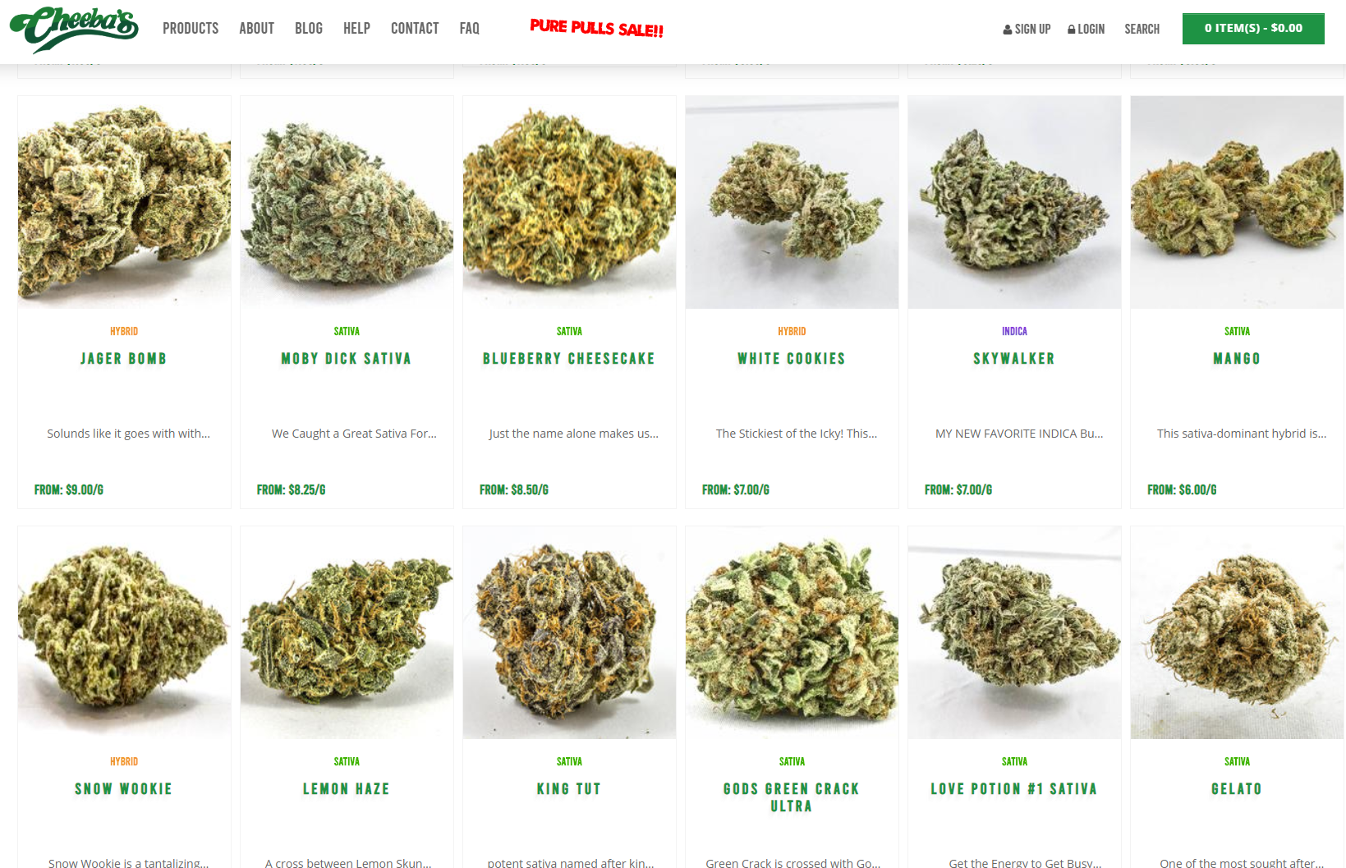
Scraping

Slide 14
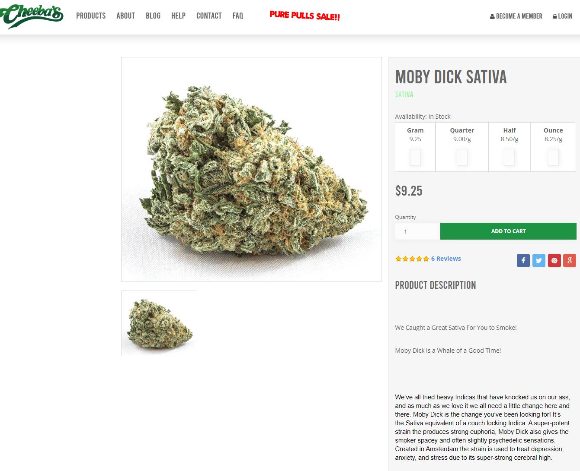
Scraping

Slide 15
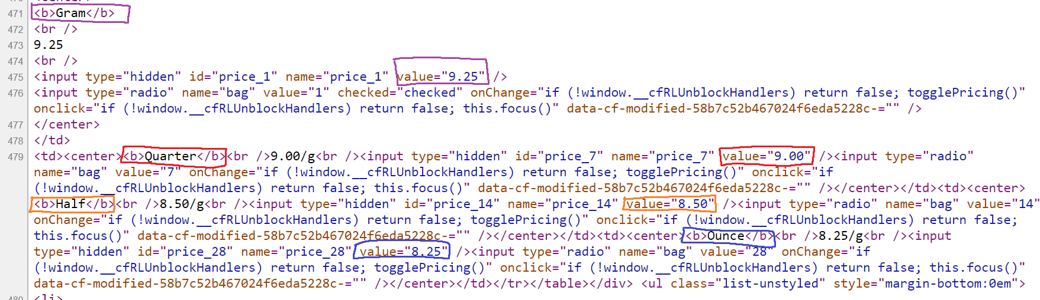
Data extraction

Slide 16
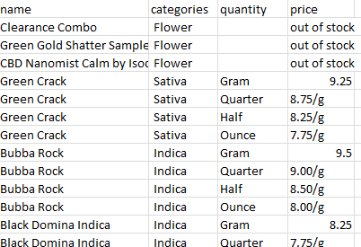
Sample data

Slide 17
Preliminary results
Scraped all 25 sites
Parsed basic data from 24 sites
There were 5986 listings
1223 of these listings were found to contain a cannabis flower product (i.e. excluded other products such as pre-rolls, concentrates, shatter, hash, vaping products, equipment)
There were 629 strains identified across these listings.

Slide 18
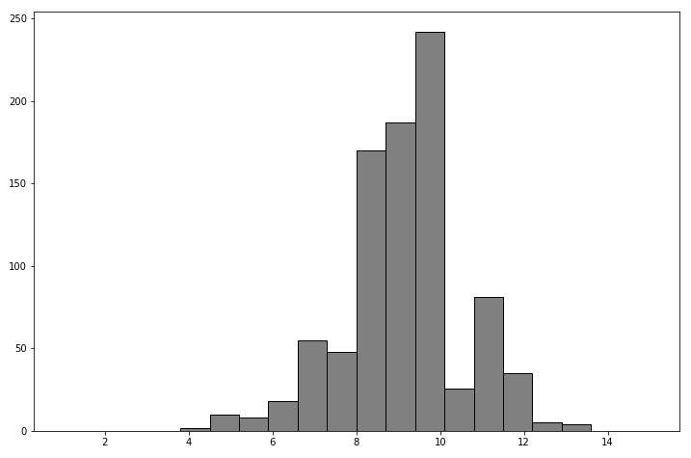
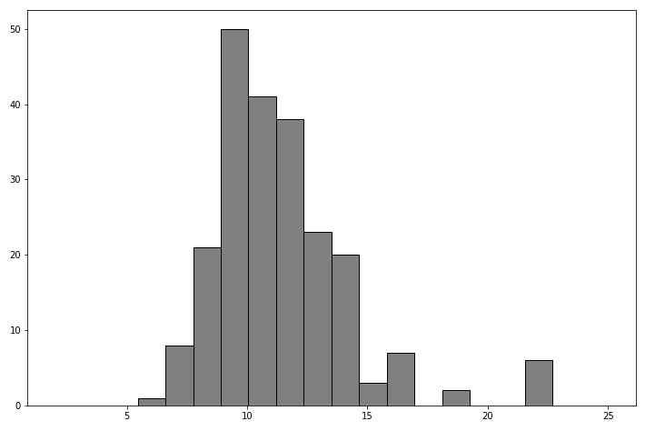
5 grams or less
$9.17 per gram (n=892)
$11.35 per gram (n=220)

Slide 19
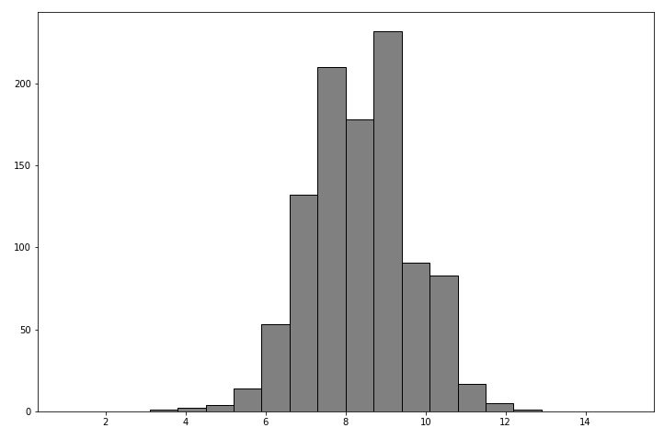
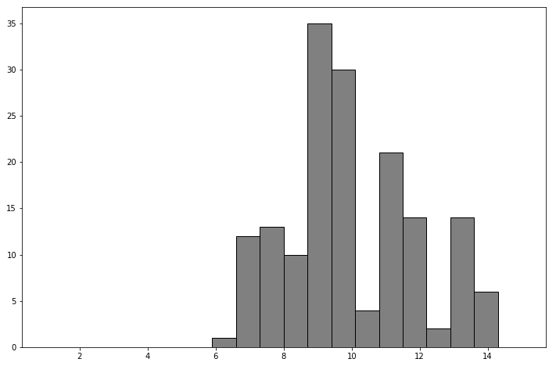
5-15 grams
$8.35 per gram (n=1024)
$10.10 per gram (n=167)

Slide 20
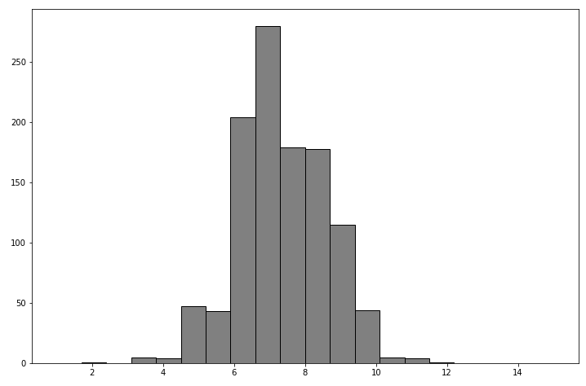
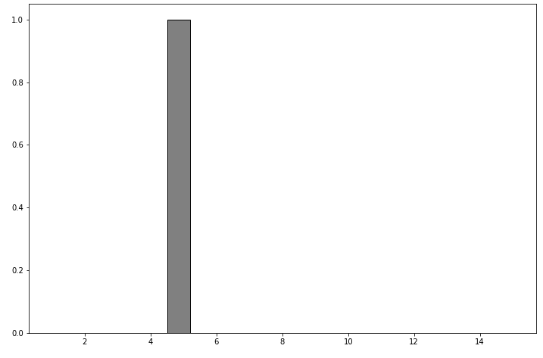
15-28 grams
$7.35 per gram (n=1110)
$5.00 per gram (n=1)

Slide 21
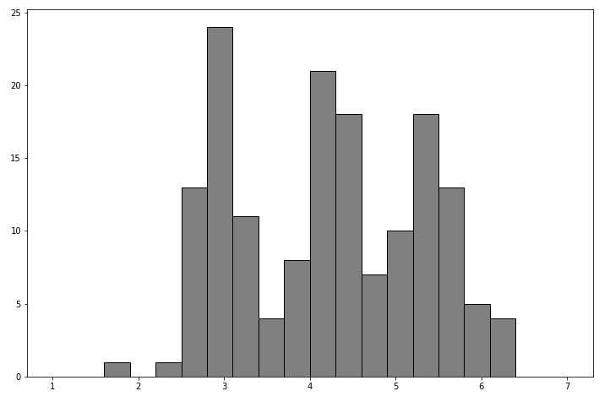
> 28 grams
$4.20 per gram (n=158)

